Slide 1
Descent methods
CHUNG Baron

Slide 2

Optimize what?
Assumption:
$f：ℝ^{n}→ℝ, convex and twice differentiable$
Optimal value can be attained finitely
Find $\min_{xεℝ^{n}}f(x)$

Slide 3
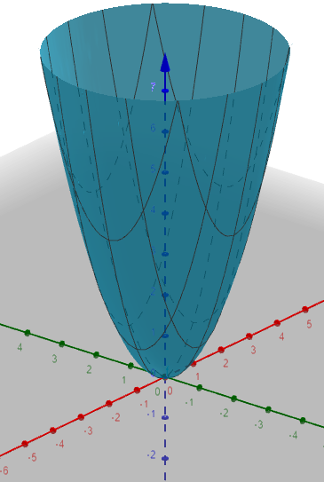



General Descent Method
$$x$$
$$Δx$$
Iterative method for solving optimality condition
$$\text{∇}f\left(x\right)=0$$
Given a starting point $x ϵ dom f$
Repeat
Determine a descent direction $Δx.$
Line search. Choose a step size $η>0$.
Update. $x≔x+ηΔx.$
Until stopping criterion is satisfied.

Slide 4
Gradient descent

Slide 5
Content
Definition of gradient descent
Simple example on gradient descent
Convergence analysis

Slide 6
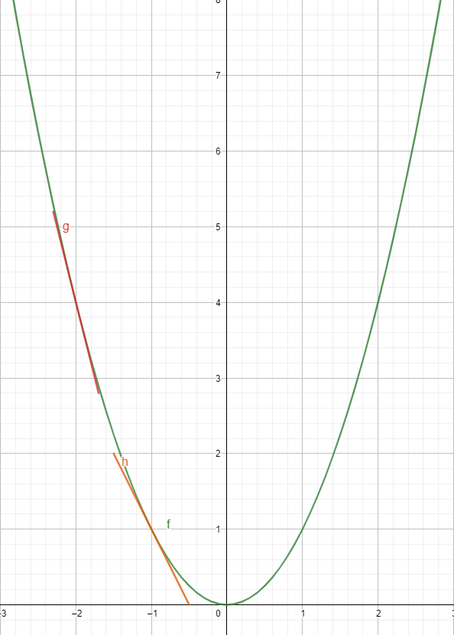
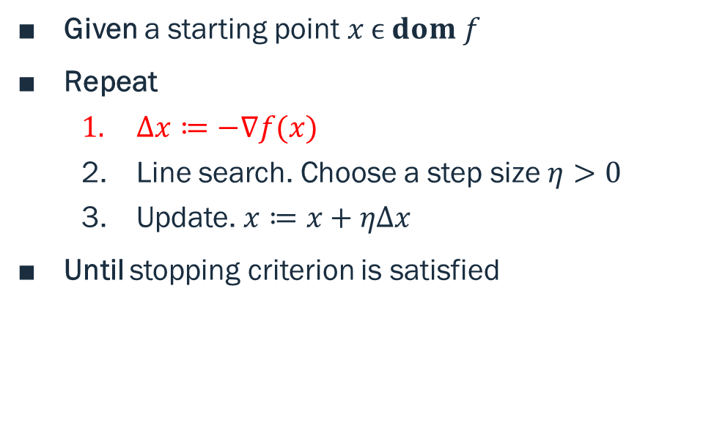
Gradient Descent
Given a starting point $x ϵ dom f$
Repeat
$Δx≔−\text{∇}f(x)$
Line search. Choose a step size $η>0$
Update. $x≔x+ηΔx$
Until stopping criterion is satisfied

Slide 7







Linear Regression
Minimize sum of squared residuals
$RSS\left(m,b\right)$
$$={\left(1.9−\left(m∗1+b\right)\right)}^{2}+{(3.1−\left(m∗2+b\right))}^{2}$$
$$+{(4.05−\left(m∗3+b\right))}^{2}$$
$$y=mx+b$$
$$d1$$
$$d2$$
$$d3$$

Slide 8
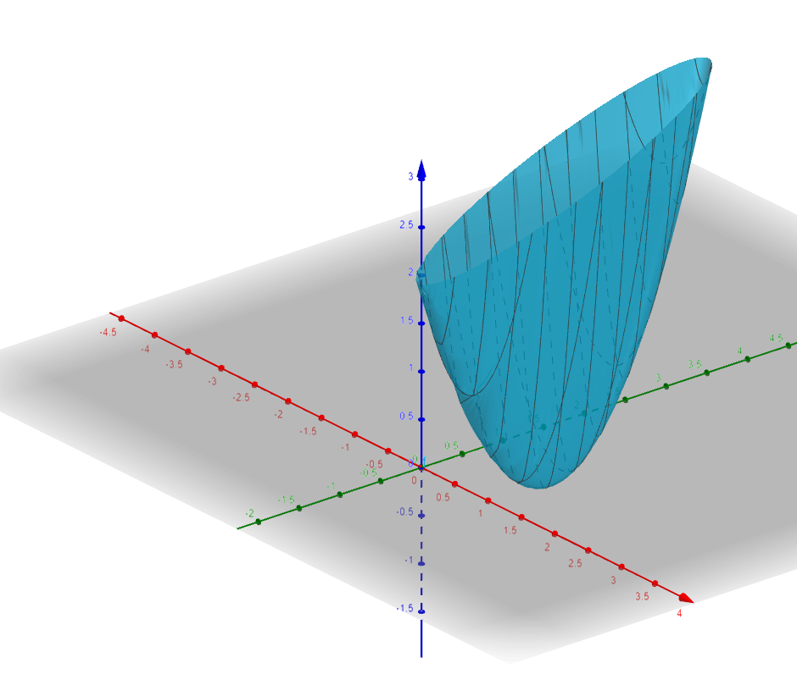

$$z=RSS\left(m,b\right)$$
Minimize sum of squared residuals
$RSS\left(m,b\right)$
$$={\left(1.9−\left(m∗1+b\right)\right)}^{2}+{(3.1−\left(m∗2+b\right))}^{2}$$
$$+{(4.05−\left(m∗3+b\right))}^{2}$$

Slide 9

Apply Gradient Descent
Compute $\frac{∂RSS(m,b)}{∂m}, \frac{∂RSS(m,b)}{∂b}$
$\frac{∂RSS(m,b)}{∂m}$ = ${2\left(1.9−\left(m∗1+b\right)\right)}^{}+{2\left(3.1−\left(m∗2+b\right)\right)∗2}^{}+{2\left(4.05−\left(m∗3+b\right)\right)∗3}^{}$
$\frac{∂RSS(m,b)}{∂b}$ = ${2\left(1.9−\left(m∗1+b\right)\right)}^{}+{2\left(3.1−\left(m∗2+b\right)\right)}^{}+{2\left(4.05−\left(m∗3+b\right)\right)}^{}$

Slide 10

Apply Gradient Descent
Initial guess: $m=1 and b=0$
${\left.\frac{∂RSS(m,b)}{∂m}\right|}_{m=1,b=0}$ = ${−2\left(1.9−\left(1∗1+0\right)\right)}^{}−{2\left(3.1−\left(1∗2+0\right)\right)∗2}^{}−{2\left(4.05−\left(1∗3+0\right)\right)∗3}^{}$
${\left.\frac{∂RSS(m,b)}{∂b}\right|}_{m=1,b=0}$= $−{2\left(1.9−\left(1∗1+0\right)\right)}^{}−{2\left(3.1−\left(1∗2+0\right)\right)}^{}−{2\left(4.05−\left(1∗3+0\right)\right)}^{}$

Slide 11

Apply Gradient Descent
Compute $\frac{∂RSS(m,b)}{∂m}, \frac{∂RSS(m,b)}{∂b}$
${\left.\frac{∂RSS(m,b)}{∂m}\right|}_{m=1,b=0}=−12.5$
${\left.\frac{∂RSS(m,b)}{∂b}\right|}_{m=1,b=0}=−6.1$

Slide 12

Apply Gradient Descent
Choose step size $η=0.01$
Update:
$m_{new}=1+12.5∗0.01=1.125$
$b_{new}=0+6.1∗0.01=0.061$
Repeat until $η\text{∇}f(x)$ is small

Slide 13
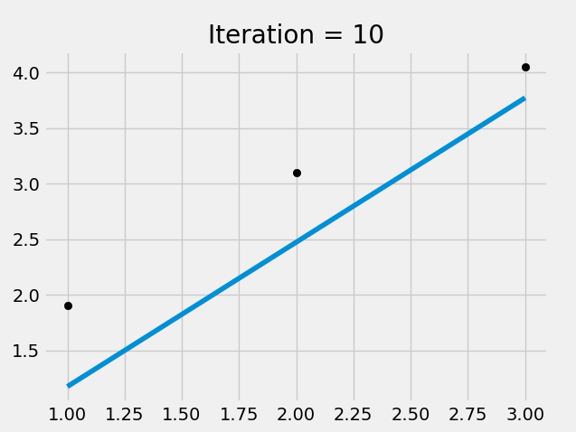
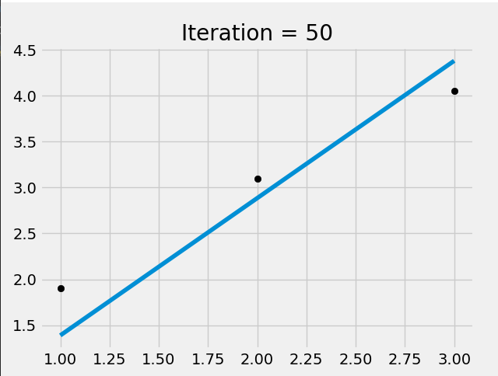

Slide 14
Convergence Analysis
Are we sure that the method converges?
What is the convergence rate?

Slide 15
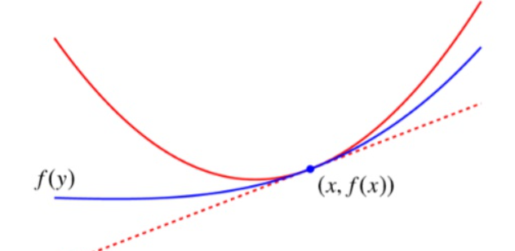
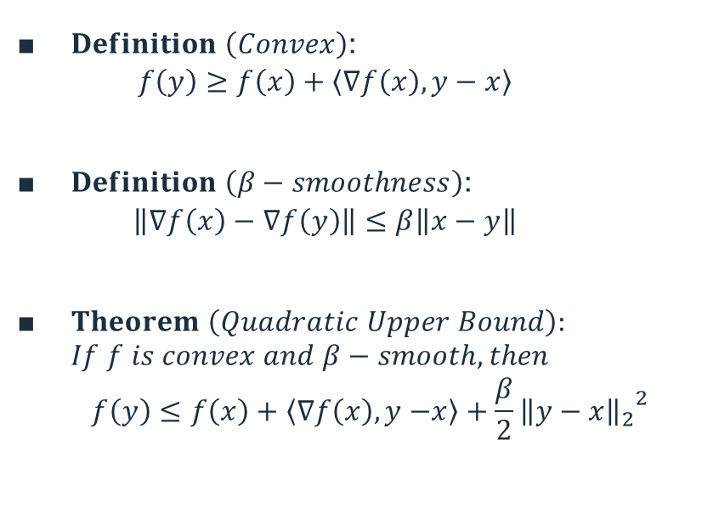
Things to know before proceeding
$Definition \left(Convex\right)$:
$$f\left(y\right)≥f\left(x\right)+\left.\left\langle \text{∇}f\left(x\right),y−x\right.\right\rangle$$
$Definition \left(β−smoothness\right)$:
$$\left.\left\|\text{∇}f\left(x\right)−\right. \text{∇}f\left(y\right)\right\|≤β\left.\left\|x−y\right.\right\|$$
$Theorem \left(Quadratic Upper Bound\right):$ $If f is convex and β−smooth, then$
$$f\left(y\right)≤f\left(x\right)+\left.\left\langle \text{∇}f\left(x\right),y−\right.x\right\rangle +\frac{β}{2}{{\left.\left\|y−x\right.\right\|}_{2}}^{2}$$

Slide 16
Convergence Analysis

Slide 17
From Gradient Descent to Newton’s Method

Slide 18
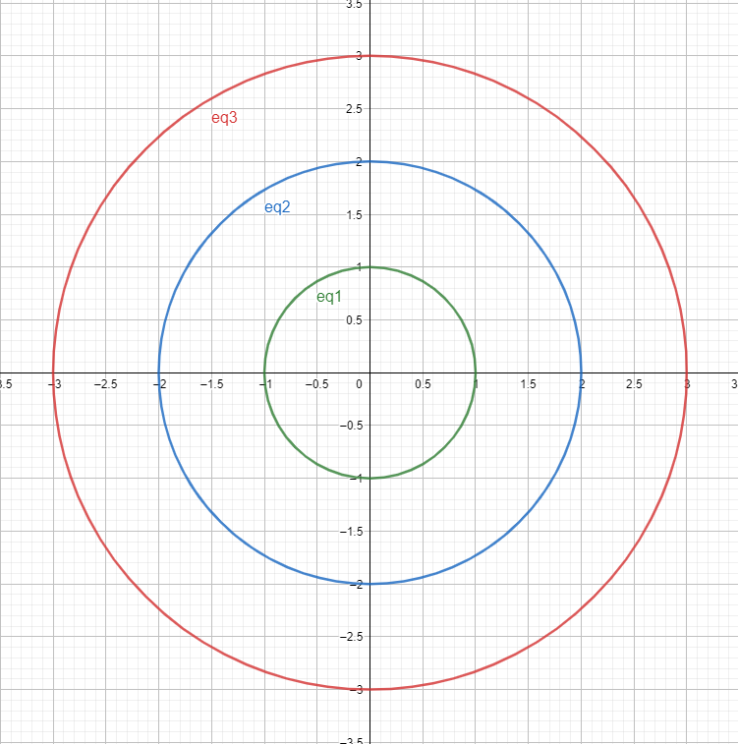
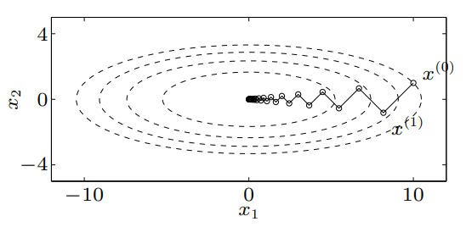
Quadratic Problem

Slide 19
Questions
Can we transform the bad elliptic curve to a perfect circle to maximize efficiency?
Is such (affine) transformation invariant under Gradient Descent?

Slide 20

Example (Transformation)
$minimize f\left(x\right)=\frac{1}{2}x^{T}Qx, Q=\left[\begin{matrix}100 & 0 \\ 0 & 1\end{matrix}\right]$
$Let A=\left[\begin{matrix}\frac{1}{10} & 0 \\ 0 & 1\end{matrix}\right] be the transformation matrix$
$Let g\left(y\right)=f\left(x=Ay\right)=\frac{1}{2}y^{T}A^{T}QAy$
$=…= \frac{1}{2}y^{T}y$

Slide 21

Example (Transformation)
$g is now 1−smooth, 1−strongly convex$
$ie. α=β=1$
$For any y_{0}, we have y_{1}=y_{0}−1∗\text{∇}\text{(}\frac{1}{2}{y_{0}}^{T}y_{0}\text{)}$
$=y_{0}−y_{0}=0$
Converging in one step

Slide 22

Example (G.D. directly on f)
$Let x_{0}=\left[\begin{matrix}0 \\ 1\end{matrix}\right]$
$x_{1}=x_{0}−\frac{1}{100}\text{∇}\text{(}\frac{1}{2}{x_{0}}^{T}Qx_{0})$
$=x_{0}−\frac{1}{100}\left(Qx_{0}\right)$
$=\left[\begin{matrix}0 \\ 1\end{matrix}\right]−\frac{1}{100}\left[\begin{matrix}0 \\ 1\end{matrix}\right]$
$=\left[\begin{matrix}0 \\ 0.99\end{matrix}\right]$
Not converging in one step

Slide 23

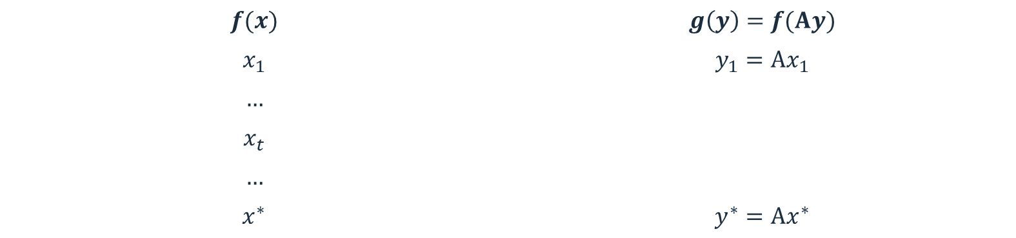
Not invariant under transformation
$$f(x)$$ | $$g\left(y\right)=f(Ay)$$
$$x_{1}$$ | $$y_{1}=Ax_{1}$$
$$…$$
$$x_{t}$$
$$…$$
$$x^{∗}$$ | $$y^{∗}=Ax^{∗}$$
$$in one step$$

Slide 24


“Best” transformation
$$λ determine \text{stretch} \text{of} \text{ellipse}\text{′}\text{s} \text{axis}$$
$Want g\left(y\right)=f\left(Ay\right) so that locally we have:$
$$\frac{λ_{max}({\text{∇}}^{2}g(y))}{λ_{min}({\text{∇}}^{2}g(y))}=1$$
$In particular, we want matrix A s.t.$
$${\text{∇}}^{2}g(y)=I$$

Slide 25


“Best” transformation
$$Aim: want matrix A s.t.$$
$${\text{∇}}^{2}g(y)=I$$
$Let g\left(y\right)=f\left(Ay\right)$
$\text{∇}g\left(y\right)=A^{T}\text{∇}f(Ay)$
${\text{∇}}^{2}g\left(y\right)=A^{T}{∗\text{∇}}^{2}f\left(Ay\right)∗A$
$Take A={({\text{∇}}^{2}f\left(Ay\right))}^{−\frac{1}{2}}$
$Then {\text{∇}}^{2}g\left(y\right)=$ ${{(({\text{∇}}^{2}f\left(Ay\right))}^{−\frac{1}{2}})}^{T}{∗\text{∇}}^{2}f\left(Ay\right)∗{({\text{∇}}^{2}f\left(Ay\right))}^{−\frac{1}{2}}$
$=I$

Slide 26
NM = GD + Transformation

Slide 27
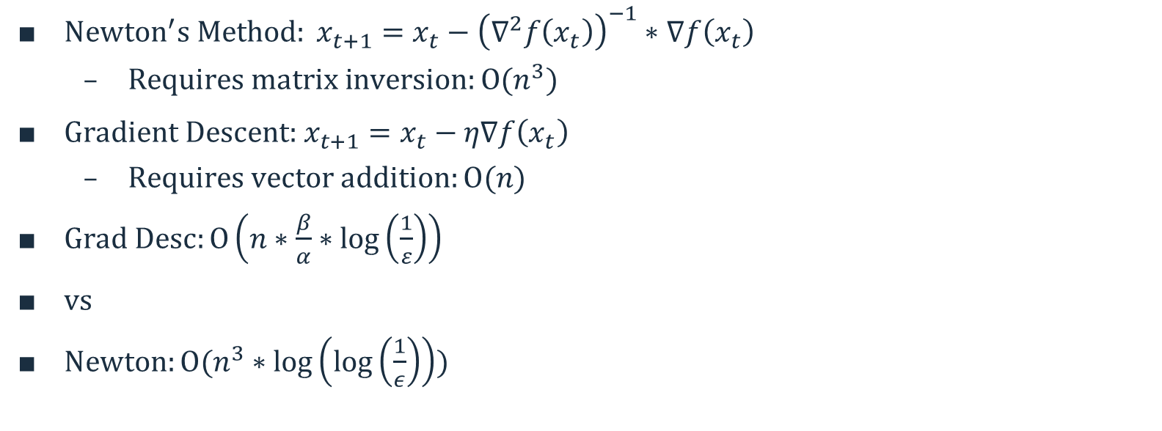
Computational Comparison
${Newton}^{′}s Method: x_{t+1}=x_{t}−{\left({\text{∇}}^{2}f\left(x_{t}\right)\right)}^{−1}∗\text{∇}f\left(x_{t}\right)$
$Requires matrix inversion:O(n^{3})$
${\text{Gradient} \text{Descent}\text{:} x}_{t+1}=x_{t}−η\text{∇}f\left(x_{t}\right)$
$Requires vector addition:O(n)$
$Grad Desc:O\left(n∗\frac{β}{α}∗\log\left(\frac{1}{ε}\right)\right)$
$vs$
$Newton:O(n^{3}∗\log\left(\log\left(\frac{1}{ε}\right)\right))$

Slide 28
Reference
Boyd, S., & Vandenberghe, L. (2004). Convex optimization. Cambridge university press. (Chapter 9.1-9.5)
Computational complexity of mathematical operations. (April 2015). In Wikipedia. https://en.wikipedia.org/wiki/Computational_complexity_of_mathematical_operations

Slide 29
End of presentation

